Slide 1
RTI@DGJMS
Response to Intervention
Jim Gibbs & Elaine Kowalchuk
Dr. George Johnson School
@jgib44 @ElaineKowalchuk
@drgjms

Slide 2
RTI: Assumptions
All students don’t learn the same way or at same speed
Some students lack prior skills & knowledge (skill)
Some students lack required behaviours (will)
Some students lack support outside of school
Teachers are doing the best they can
Teachers cannot meet the needs of all students

Slide 3
The Wrong Assumption
It’s my job to teach and students job to learn
Instead we as educators take collective responsibility to ensure high levels of learning for all students

Slide 4
Why the Urgency?
• ϑοην Hatties Research
Typical school effect on achievement
A year of maturation .1
A year of teachers instruction .3
We can expect the average student to academically improve .4 just by showing up at school
Home Effect (effect on achievement)
Socioeconomic status -.57
Home environment -.57
Parental involvement -.51
• You can see what a big advantage students from a typical middle class home have in school
• For many students we will have to make up for the Home Effect > that’s a big goal of RTI!
> RTI Effect - 1.4

Slide 5
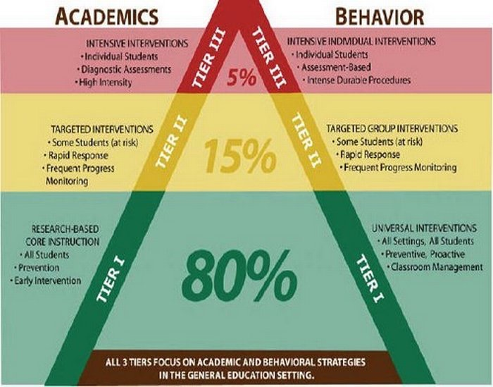
What is RTI?

Slide 6
Assessment Matrix
 | Tier 1 | Tier 2 | Tier 3
Reading | Star Reading/ Class Based Assessment | Fountas & Pinnel | Jerry Johns
Math | YEMA/Class Based Assessment/ Star Math | Class Based Assessment | Key Math
Behaviour | Universal Behavior Assessment / Behaviour Reports | Functional Behaviour Assessment | Behaviour Support Team/ BIP

Slide 7
Planning Matrix
Student Support Mtgs (4) | Principal | Student Service (RT/Cn) | Classroom Teacher
Data Team Mtgs (5) | Principal | Classroom Teachers | Co-Teacher
Student Services Mtgs (bi-monthly) | Principal | Resource Teacher | Counsellor

Slide 8
Intervention Matrix
 | Tier 1 | Tier 2 | Tier 3
Reading | - Core Curriculum (Reciprocal Reading/Literacy Circles/Accelerated Reader) | - Reading Intervention: Class Tch./Raz / Epic / Accelerated Reader* | - Reading Intervention (RT)
Math | Co-Teach/School Wide Math Plan | Co-Teach/Math Int./ Accelerated Math* | - Math Int. (CT/RT)
Behaviour | Cougar Code/PBIS/Restitution | Small Grp/Contracts | BIP/Academic Advisory Program ("Will")

Slide 9
Review

Slide 10
Results

Slide 11
Final Thoughts
Finding Time
Data Collection/ Decision Making
Culture Change : Collective Responsibility
Questions?

Slide 12
Bonus Slide
RTI@Brown International Academy

Slide 13
RTI@DGJMS
More info:
Enhancing RTI, How to Ensure Success with Effective Classroom Instruction and Intervention, D. Fisher and N. Frey
www.pbis.org/rti
http://www.rtinetwork.org
email: james.gibbs@esd.ca elaine.kowalchuk@esd.ca

